Slide 1


Slide 2
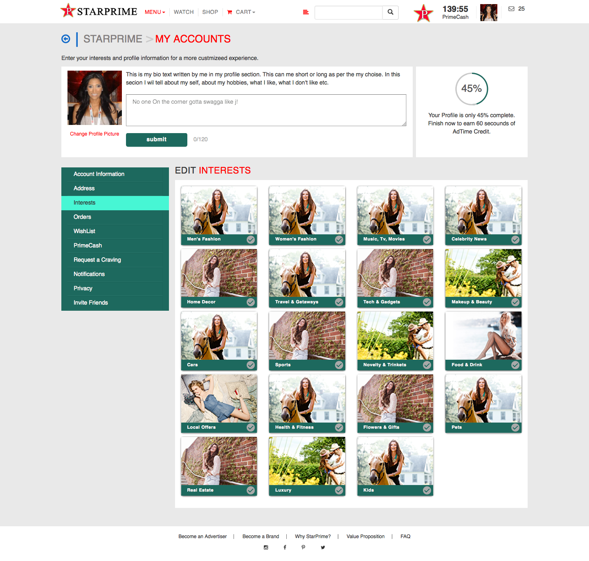



AMPLIFYON
AMPLES
AMPLIFYON
Reward Time
AMPLES
Amples

Slide 3
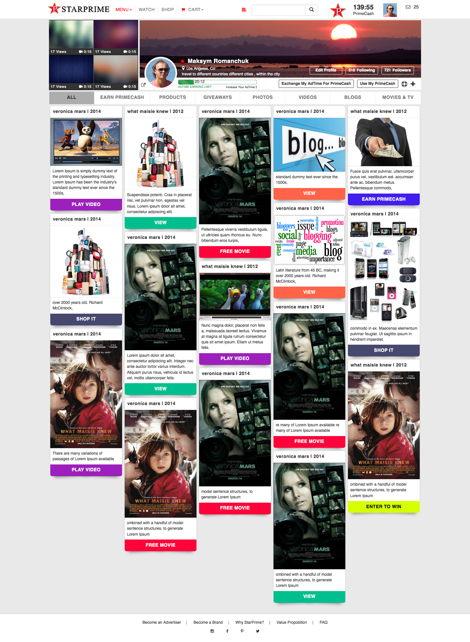

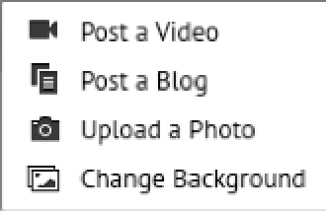

AMPLIFYON
AMPLES
Reward Time
Reward Time
Reward Time
AMPLES
AMPLES
AMPLES
Reward Time
AMPLES

Slide 4
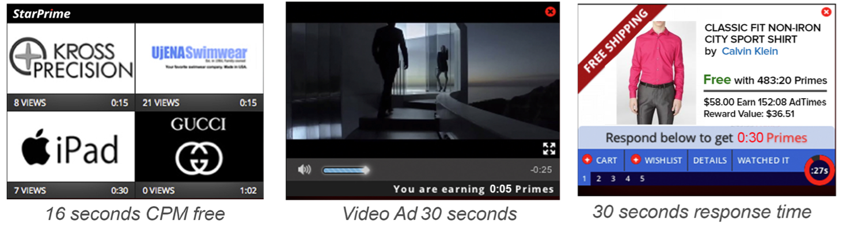
AMPLIFYON
AMPLES
Reward Time
AMPLES
AMPLES

Slide 5
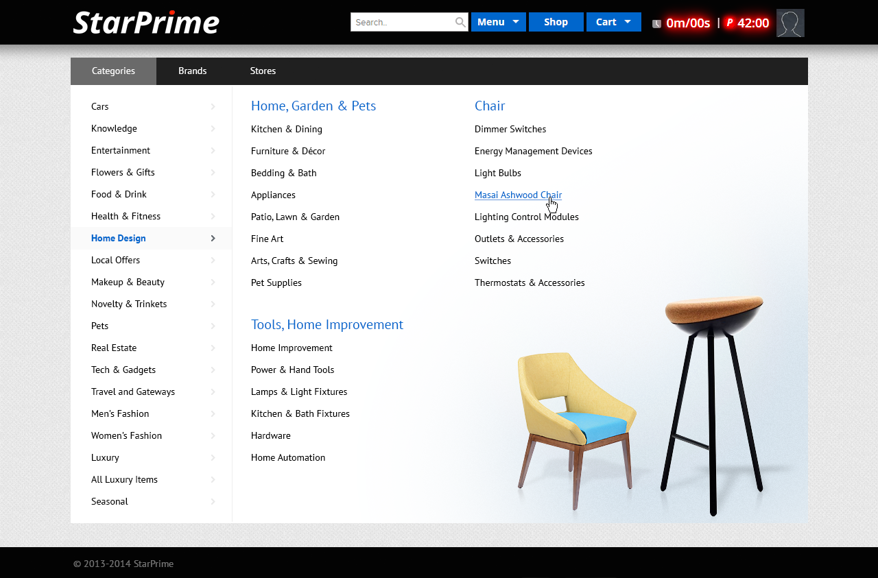

Slide 6

AMPLIFYON
AMPLES
AMPLES
AMPLES
AMPLES

Slide 7
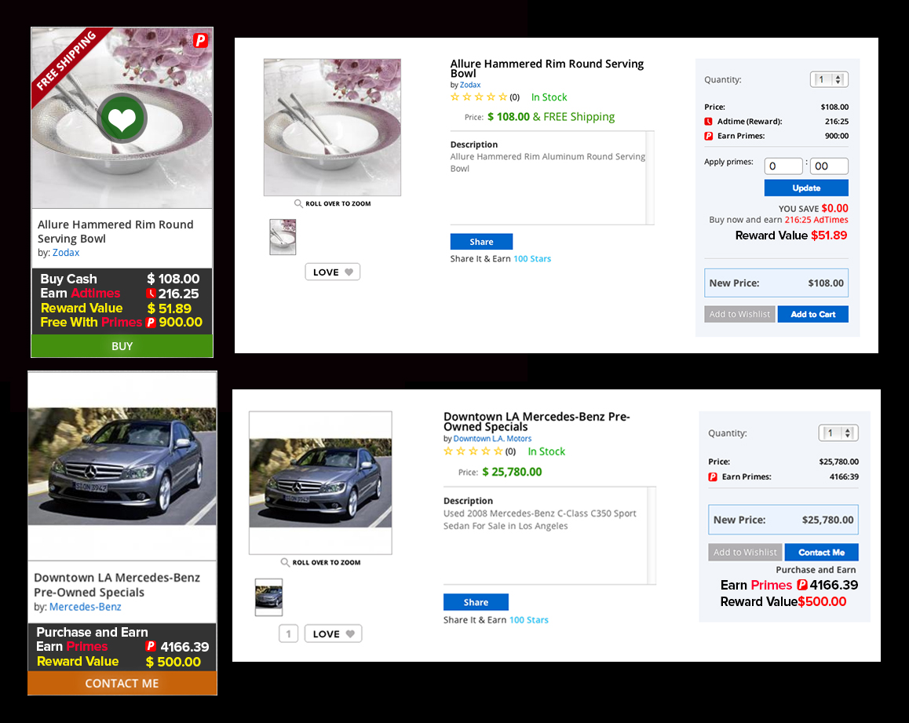
Reward Time
234:00
AMPLES
AMPLES
900
You Earn 52%
234:00
Reward Time
$56.16
60 Seconds of Reward Time
Reward Time
$0.00
AMPLES
AMPLES
AMPLES
AMPLES
60 Seconds of Reward Time
AMPLES

Slide 8
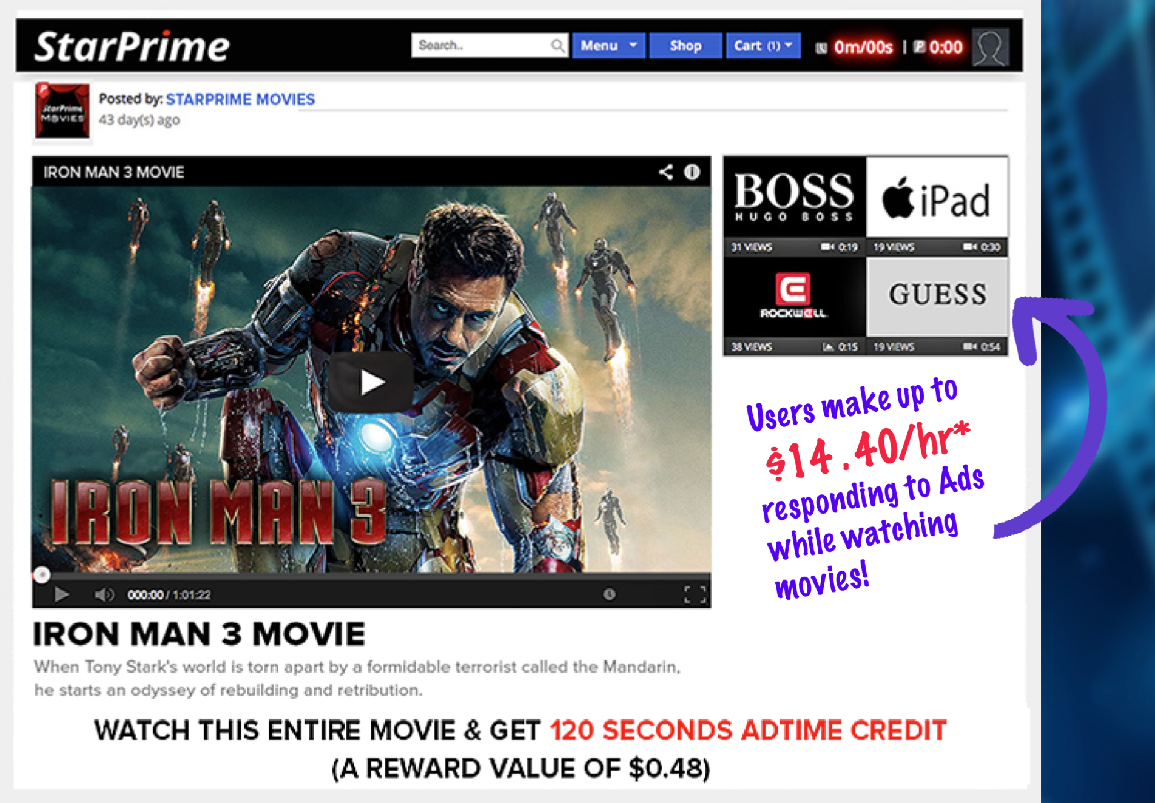
AMPLIFYON
Reward Time

Slide 9
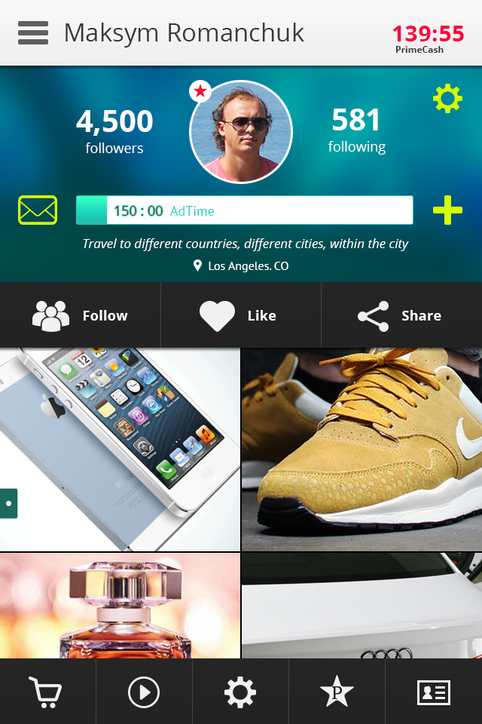
AMPLES
Reward Time

Slide 10
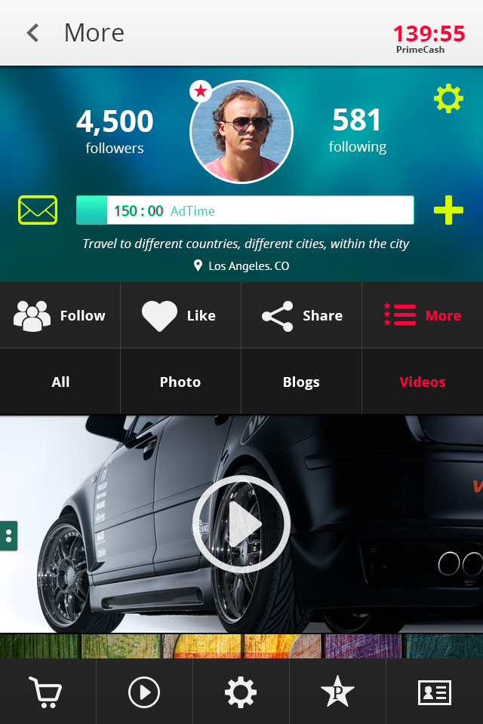
AMPLES
Reward Time

Slide 11

AMPLES

Slide 12
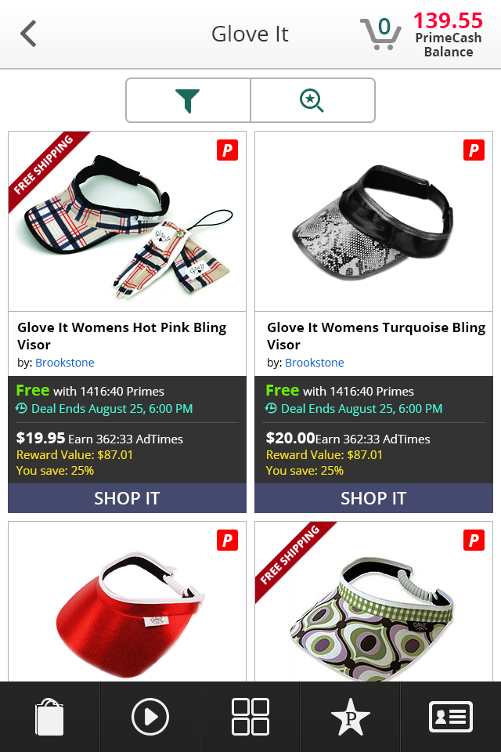
AMPLES
AMPLES
AMPLES
Reward Time
Reward Time

